Slide 1
Evolving a Reversi Player
Anna Porter
Research Advisor: Dr. Rob LeGrand III
Summer II 2018

Slide 2
Reversi
8x8
64 identical pieces
Initial boardstate
Flips
Legal moves
Passing
No voluntary passing
Score

Slide 3
Flip example
All 8 Directions
More than one at a time

Slide 4
Flip example
All 8 Directions
More than one at a time

Slide 5
Neural Network Example
Inputs
W_{0,1,0}= 1.25
Weights: layer, destination, origin
W_{0,1,1}= 0.5
1
Neuron 1
W_{1,1,1}= 3
W_{0,2,1} = -0.75
Output Neuron
W_{1,1,2}= 4
W_{0,1,2} = 0.25
W_{0,2,2} = 1.5
Neuron 2
W_{1,1,0}= 2.5
x=-1
W_{0,2,0}= -2

Slide 6
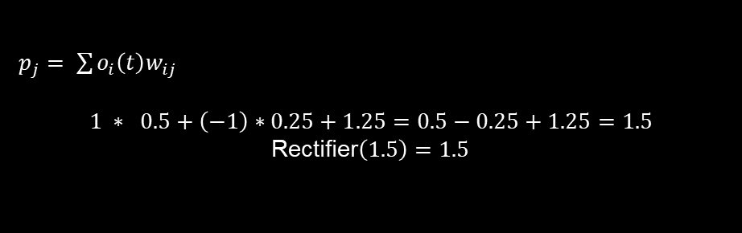
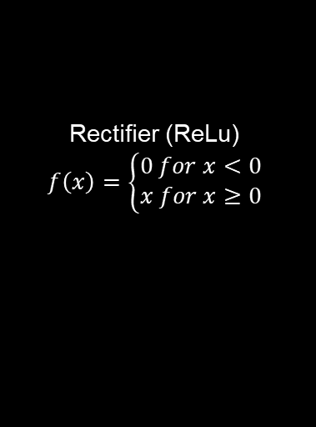
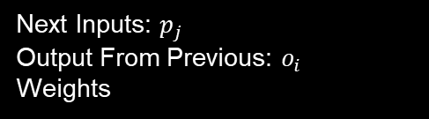
Neuron 1
Next Inputs: $p_{j}$
Output From Previous: $o_{i}$
Weights
Inputs
W_{0,1,0}= 1.25
W_{0,1,1}= 0.5
1
Neuron 1
1.5
W_{0,1,2} = 0.25
$p_{j}= \sum{o_{i}\left(t\right)w_{ij}}$
$$1 ∗ 0.5+\left(−1\right)∗0.25+1.25=0.5−0.25+1.25=1.5$$
Rectifier$\left(1.5\right)=1.5$
-1
Rectifier (ReLu)
$$f\left(x\right)=\left\{\begin{aligned}0 for x<0 \\ x for x≥0\end{aligned}\right.$$

Slide 7
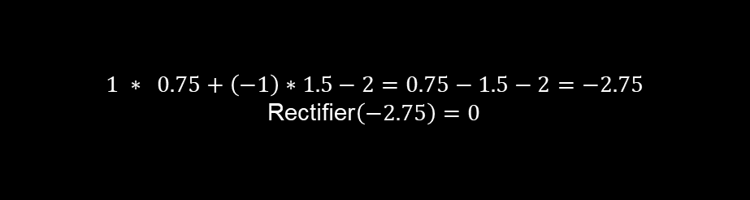
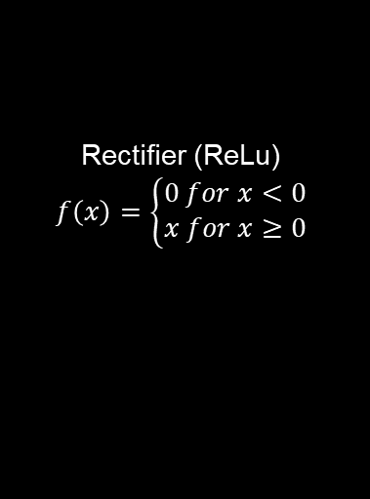
Neuron 2
Rectifier (ReLu)
$$f\left(x\right)=\left\{\begin{aligned}0 for x<0 \\ x for x≥0\end{aligned}\right.$$
Inputs
$$1 ∗ 0.75+\left(−1\right)∗1.5−2=0.75−1.5−2=−2.75$$
Rectifier$\left(−2.75\right)=0$
1
W_{0,2,1} = -0.75
W_{0,2,2} = 1.5
Neuron 2
0
-1
W_{0,2,0}= -2
Notes:
Make the output here negative to demonstrate other condition of rectifier

Slide 8
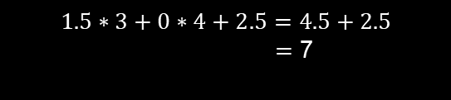
Output Neuron
1.5
$$1.5∗3+0∗4+2.5=4.5+2.5$$ $=$ 7
W_{1,1,1}= 3
Output Neuron
W_{1,1,2}= 4
0
W_{1,1,0}= 2.5

Slide 9
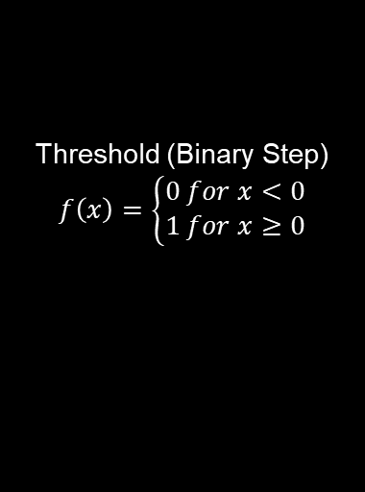
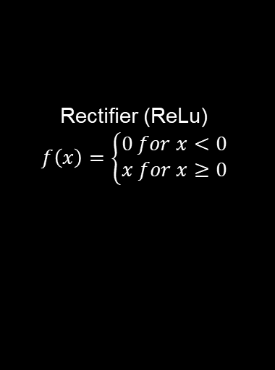
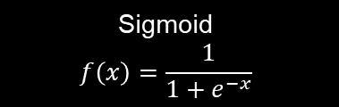

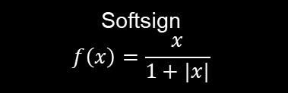
Activation Functions
Softsign
$$f\left(x\right)=\frac{x}{1+|x|}$$
Rectifier (ReLu)
$$f\left(x\right)=\left\{\begin{aligned}0 for x<0 \\ x for x≥0\end{aligned}\right.$$
Sigmoid
$$f\left(x\right)=\frac{1}{1+e^{−x}}$$
Threshold (Binary Step)
$$f\left(x\right)=\left\{\begin{aligned}0 for x<0 \\ 1 for x≥0\end{aligned}\right.$$
Softplus
$$f\left(x\right)=ln({1+e^{x})}$$

Slide 10
Genetic Algorithm
Algorithm: GA(n, χ, µ) // Initialise generation 0: k := 0; Pk := a population of n randomly-generated individuals; // Evaluate Pk: Compute fitness(i) for each i ∈ Pk; do { // Create generation k + 1: // 1. Copy: Select (1 − χ) × n members of Pk and insert into Pk+1; // 2. Crossover: Select χ × n members of Pk; pair them up; produce offspring; insert the offspring into Pk+1; // 3. Mutate: Select µ × n members of Pk+1; invert a randomly-selected bit in each; // Evaluate Pk+1: Compute fitness(i) for each i ∈ Pk; // Increment: k := k + 1; } while fitness of fittest individual in Pk is not high enough; return the fittest individual from Pk;

Slide 11
Fitness Score
Win: 64 points
Loss: 0 points
Draw: 32 points
Pieces Controlled: x points

Slide 12
Parent Selection Example
Parent | Fraction | Percentage
Father 1 | 323 / 1478 | 21.85%
Father 2 | 0 / 1478 | 0%
Father 3 | 200 / 1478 | 13.53%
Father 4 | 475 / 1478 | 32.14%
Father 5 | 256 / 1478 | 17.32%
Father 6 | 224 / 1478 | 15.16%
Father1
423
Father1
323
Father6
324
Father2
100
Father6
224
Father2
0
Mother
Mother
Father5
356
Father3
300
Father5
256
Father3
200
Father4
575
Father4
475

Slide 13
Crossover Example
W_{0,1,0} = 1
W_{0,1,1} = 7
W_{0,1,2} = 4
W_{1,1,0} = 3
W_{1,1,1} = 9
W_{1,1,2} = 6
Mother
W_{0,2,0} = 5
W_{0,2,1} = 2
W_{0,2,2} = 8
W_{0,1,0} = 8
W_{0,1,1} = 7
W_{0,1,2} = 1
W_{1,1,0} = 3
W_{1,1,1} = 9
W_{1,1,2} = 4
Child
W_{0,2,0} = 3
W_{0,2,1} = 9
W_{0,2,2} = 8
W_{0,1,0} = 8
W_{0,1,1} = 6
W_{0,1,2} = 1
W_{1,1,0} = 5
W_{1,1,1} = 2
W_{1,1,2} = 4
Father
W_{0,2,0} = 3
W_{0,2,1} = 9
W_{0,2,2} = 7

Slide 14
Mutation
Normal Shake
Uniform Shake
Cauchy Shake
1% replace

Slide 15
Vanilla Configuration
Reversi Board: 8x8
Inputs: -1, 0, 1
Population Size: 10x10
1 hidden layer 8 neurons
Softplus
One move ahead
Normal Distribution Initialization (Mean: 0, Standard Deviation: 1)
Parent Selection 6 neighbors, weighted fitness

Slide 16
Activation Function Comparison

